Slide 1
Web Analytics Comparing Yelp and TripAdvisor Reviews
Team 3:
Jasmeet Kaur Rajpal Hardik Cheddha Advait Gupte Yash Shah

Slide 2
Introduction
To determine for a particular whether Yelp and TripAdvisor reviews and ratings are different
To find what kind of words are affecting the ratings of any restaurant

Slide 3
Basic Idea
The project was started by scraping Reviews, Rating and Date from TripAdvisor and Yelp for several restaurants.
These scraped reviews, ratings and date are stored in text file by the restaurant names
Ratings of these restaurants are compared using the T-Test to show the difference in Ratings
By performing Fisher Test on the words from the reviews to find which words affect the ratings of the restaurants

Slide 4
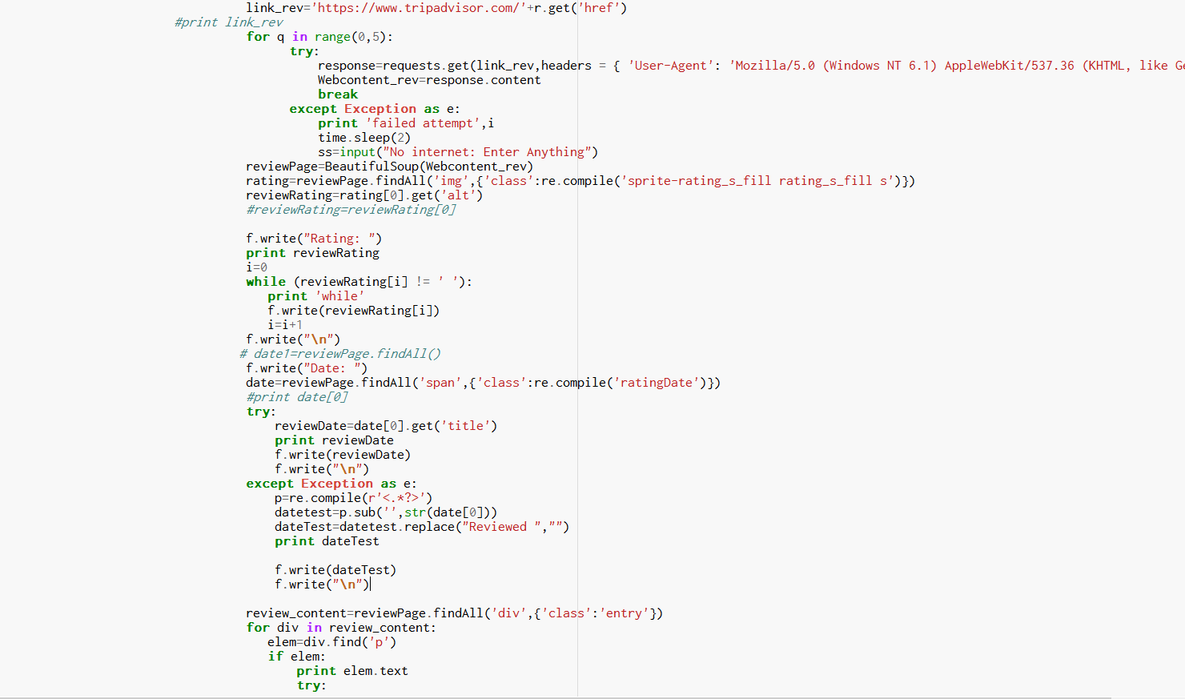
Scrapping – Trip Advisor

Slide 5
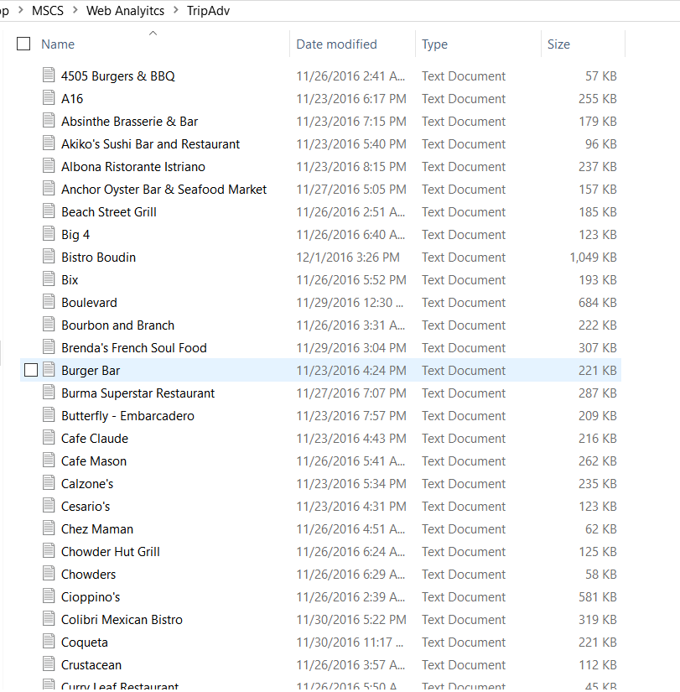
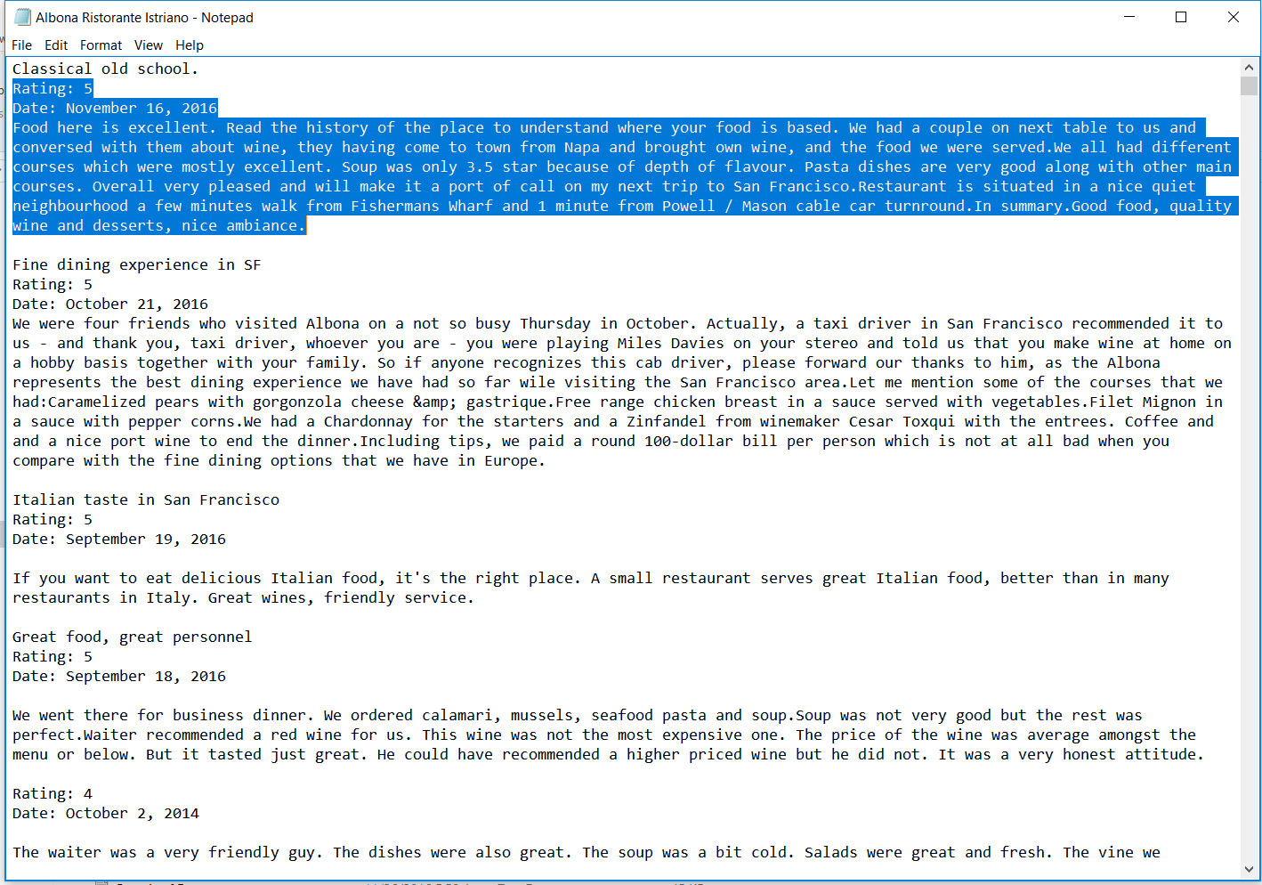
Scrapping – Trip Advisor Output

Slide 6
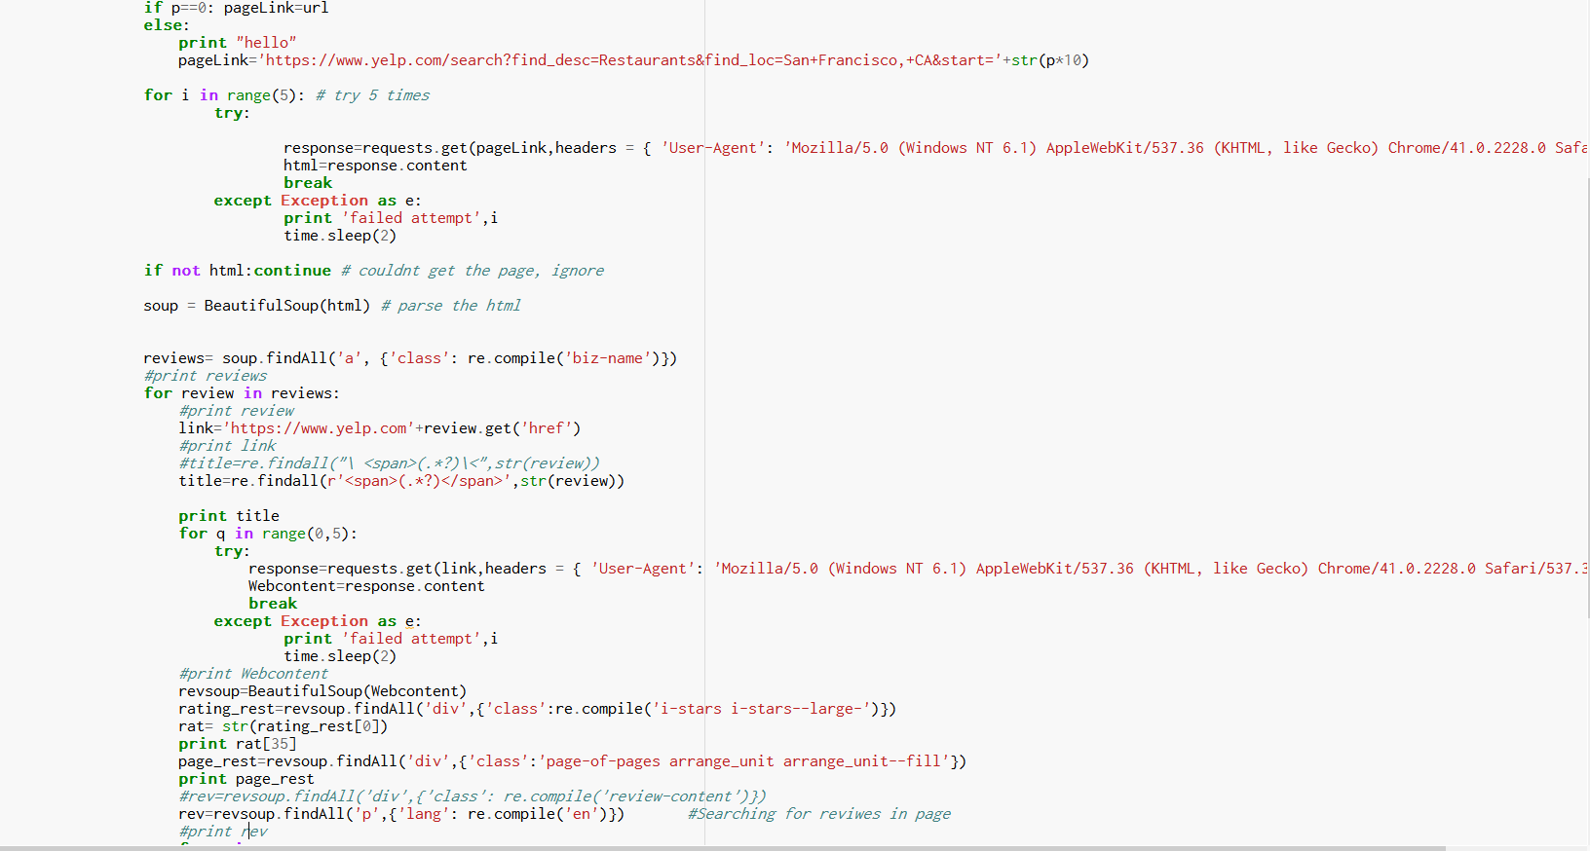
Scrapping – Yelp

Slide 7
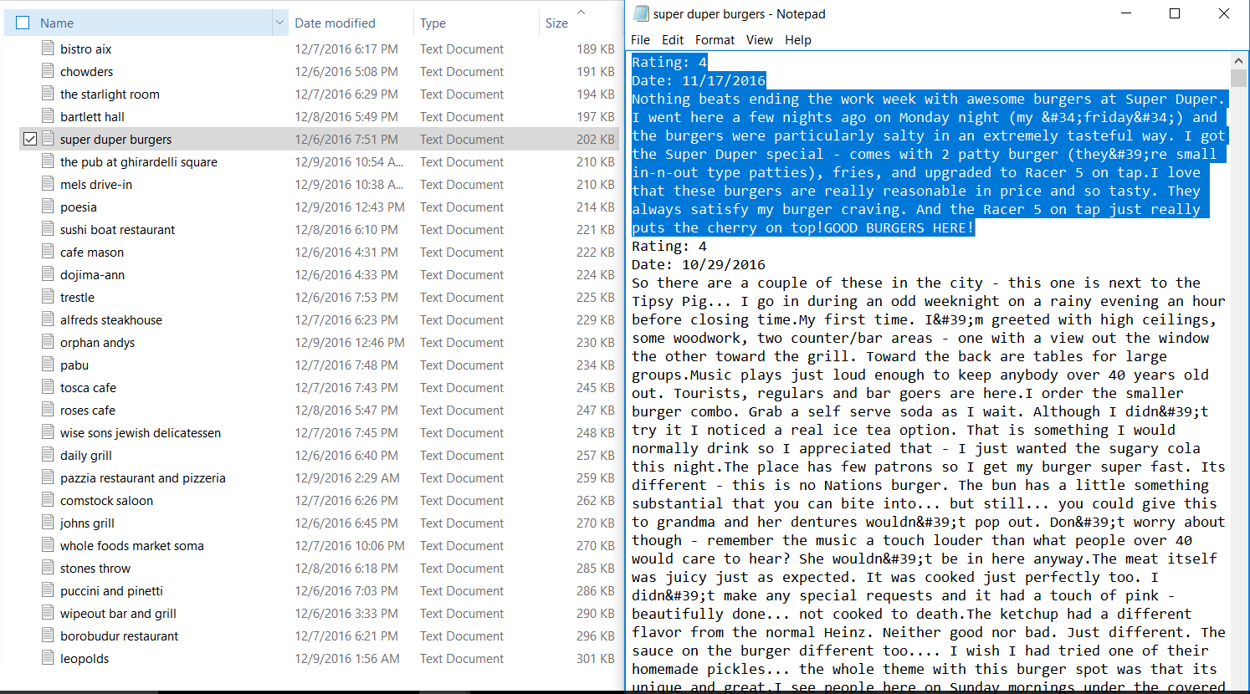
Scrapping – Yelp Output

Slide 8
T-Test
Conducted T-Test on ratings of each restaurant.
Observed most of the P-values was less than 0.05.
This indicated that the average of the rating were significantly different for Trip Advisor and Yelp.

Slide 9
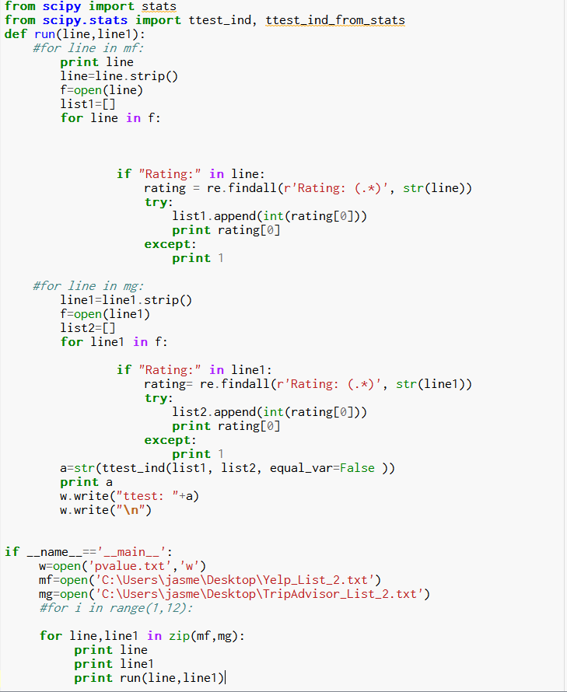
Code Snippet for T-Test

Slide 10
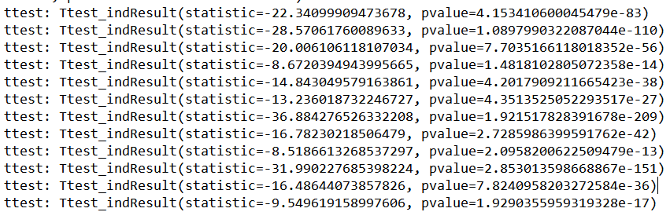
T-Test Output

Slide 11
Fisher’s Test
Calculated occurrences of the words in the reviews of Trip Advisor and Yelp for each restaurant.
Conducted Fisher’s Test on each word to find out which words are having significant difference in occurrence.
Words having P-value less than 0.05 indicate that those words affect the ratings and reviews.

Slide 12
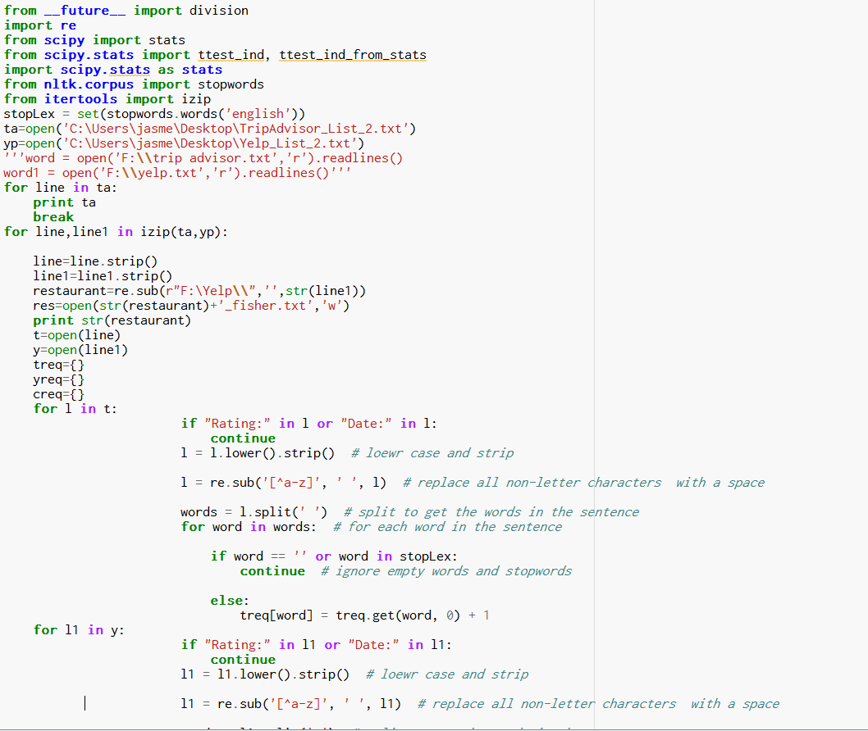
Code Snippet for Fisher’s Test

Slide 13
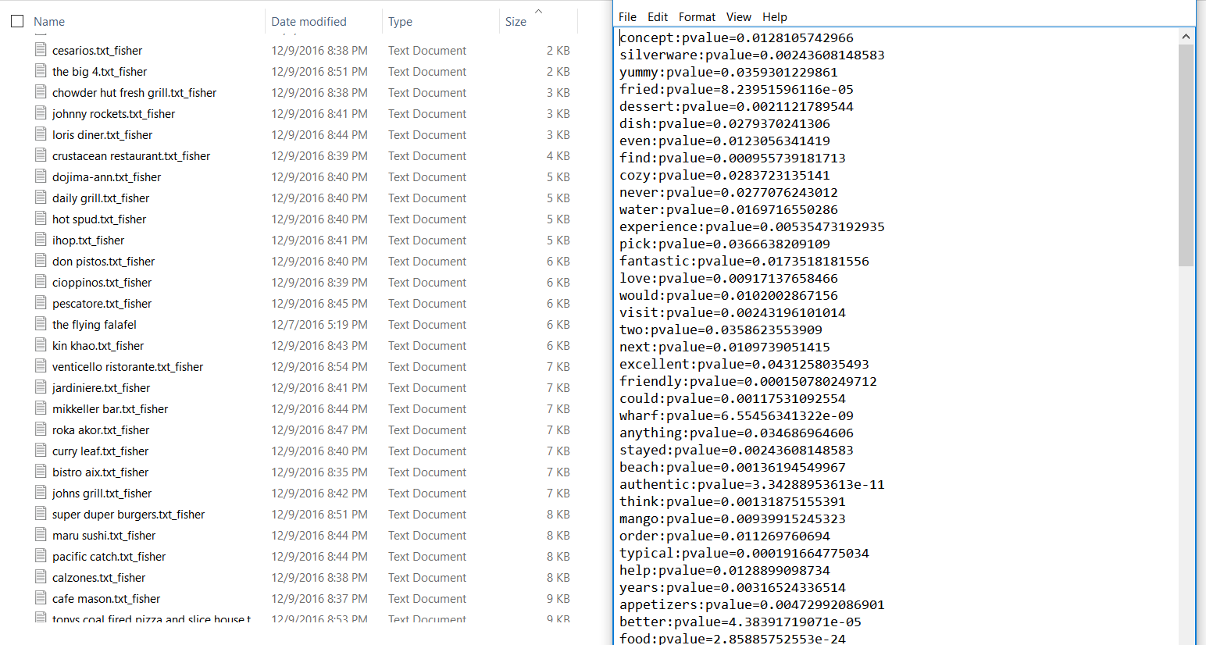
Fisher’s Test Output

Slide 14
THANK-YOU

